Slide 1
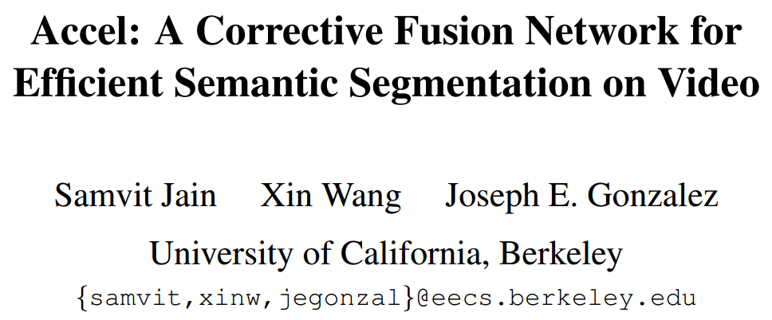
CVPR2019 oral

Slide 2
Motivation
This task becomes more expensive for video’s temporal frame rate（高视频帧率造成计算代价大）
By ignoring temporal context, frame-by-frame approaches fail to realize the potential for improved accuracy offered by the availability of preceding frames in a scene.（frame-by-frame的方法没有利用先序帧的信息）

Slide 3
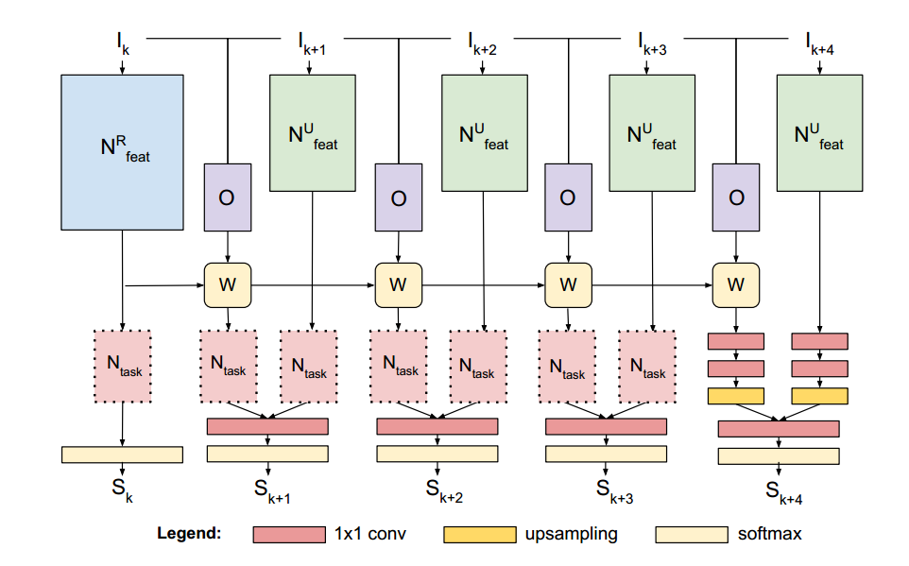
Pipeline
N^{R}, N^{U},
feature network
O,
optical flow estimation
N_{task},
pixel-wise classifier
W,
spatial warp
(0, 0) | (0, 1) | (0, 2)
(1, 0) | (1, 1) | (1, 2)
(2, 0) | (2, 1) | (2, 2)
(0, 1) | (0, 2) | inter
(1, 1) | (1, 2) | inter
(2, 1) | (2, 2) | inter
W

Slide 4
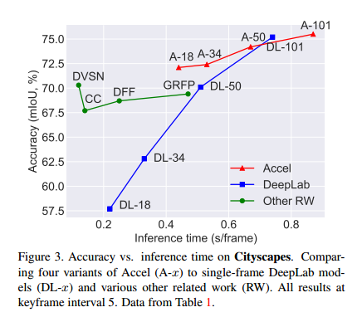
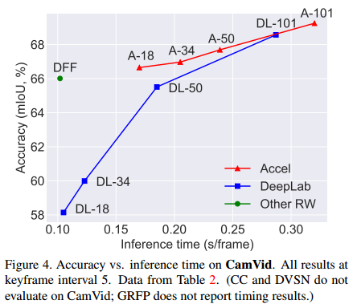
Ablation

Slide 5
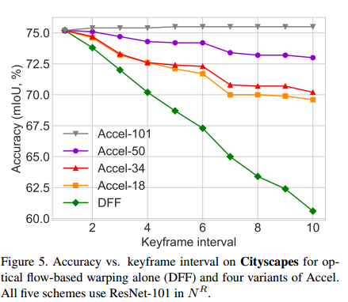
Ablation

Slide 6
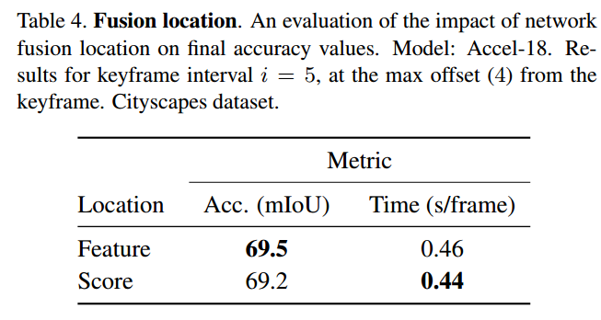
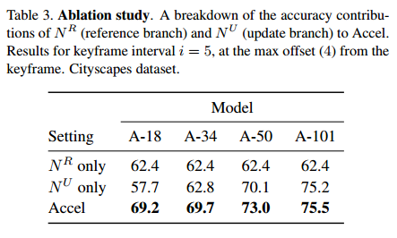
Ablation

